Slide 1
Medal Design Log
By Mr Graham

Slide 2
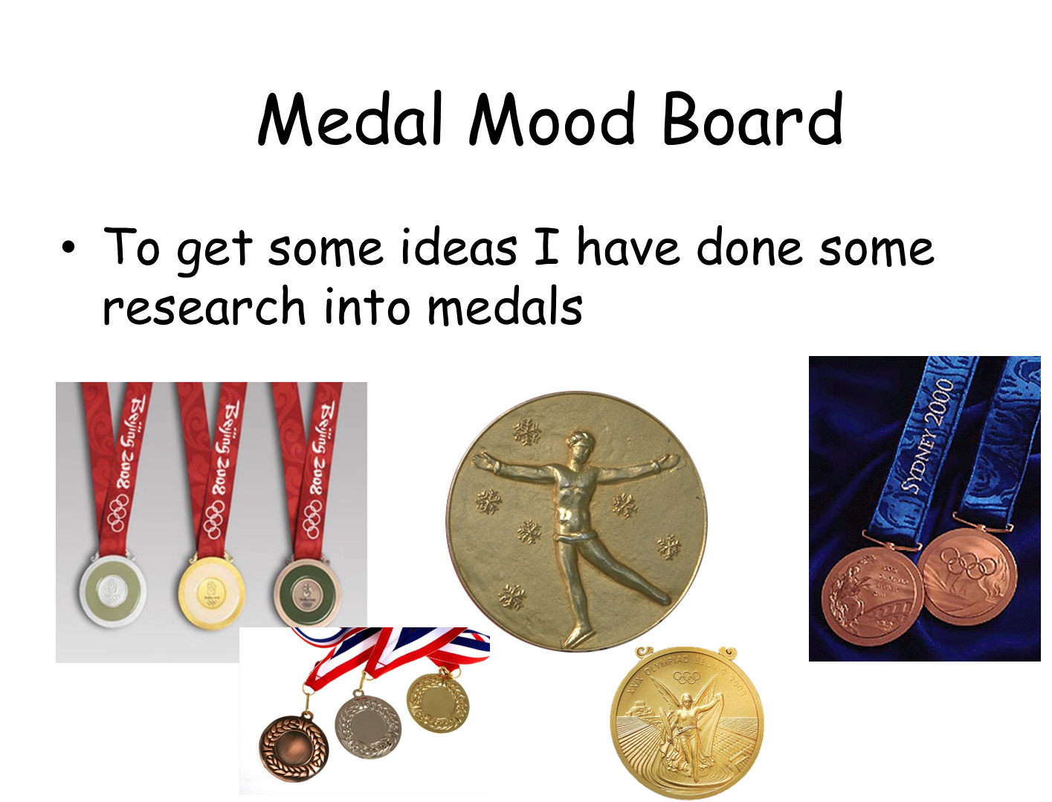

Slide 3
Medal Design Brief
be created using only vector tools
be actual size
not exceed 80 mm in any dimension
include your logo and the text 'On your marks!' on the front
have a graphic to represent your chosen event on the back
show how the ribbon will be attached
show dimensions
appeal to your target audience

Slide 4
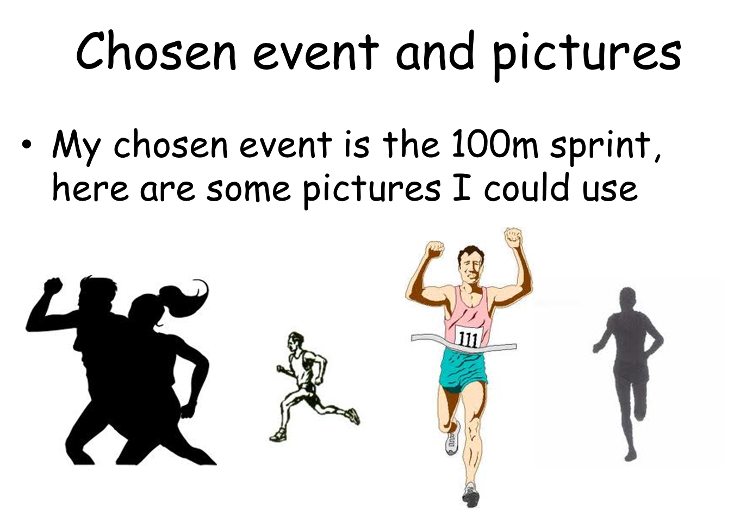

Slide 5
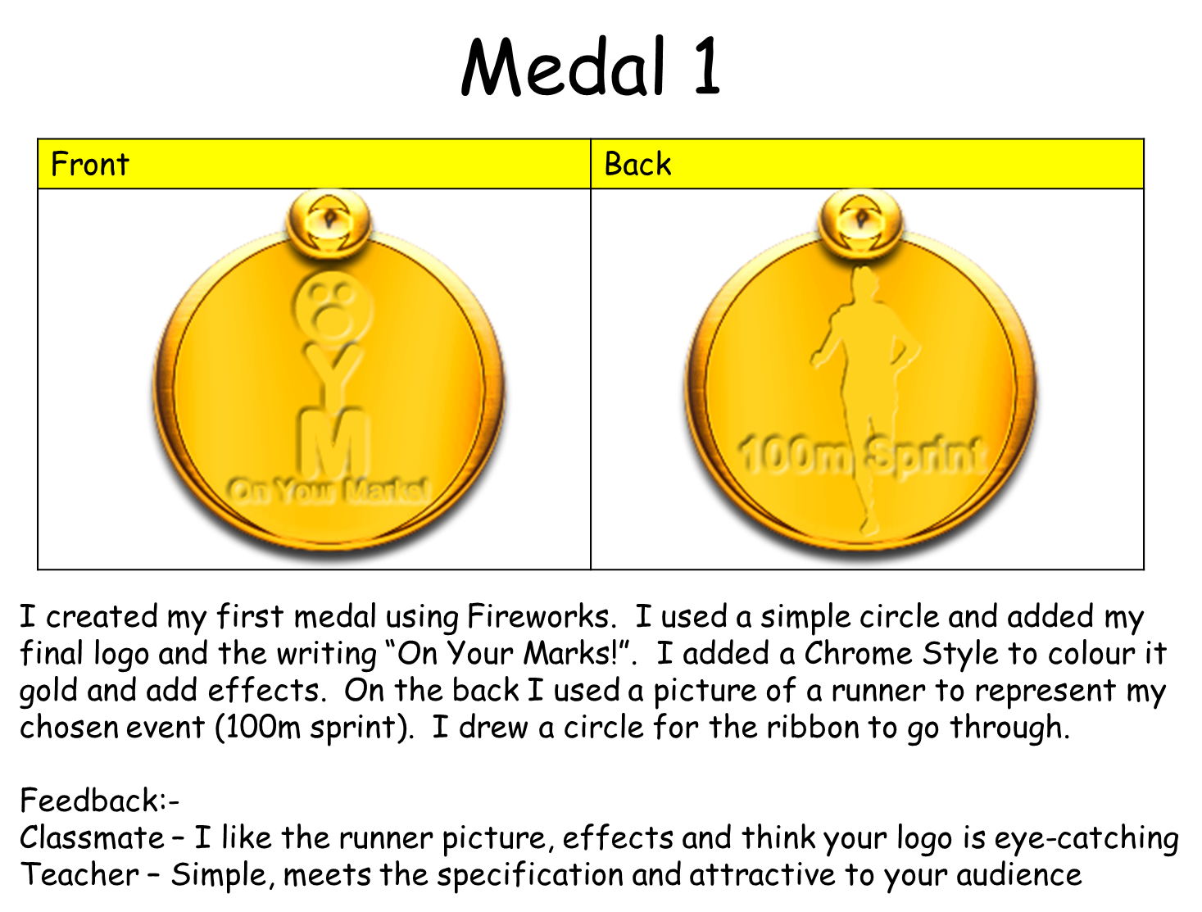

Slide 6
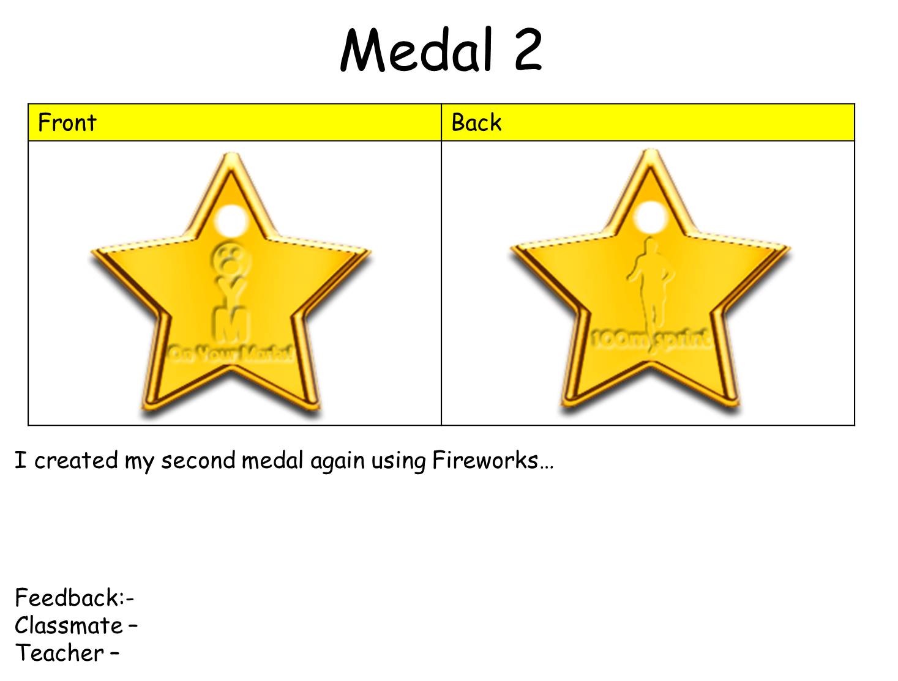

Slide 7
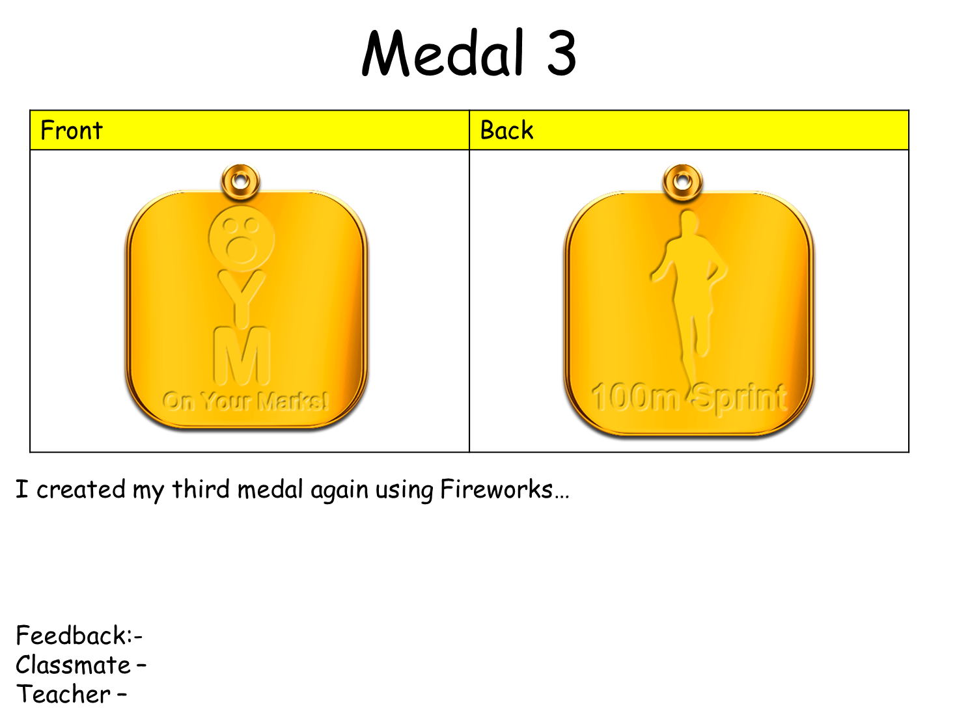

Slide 8
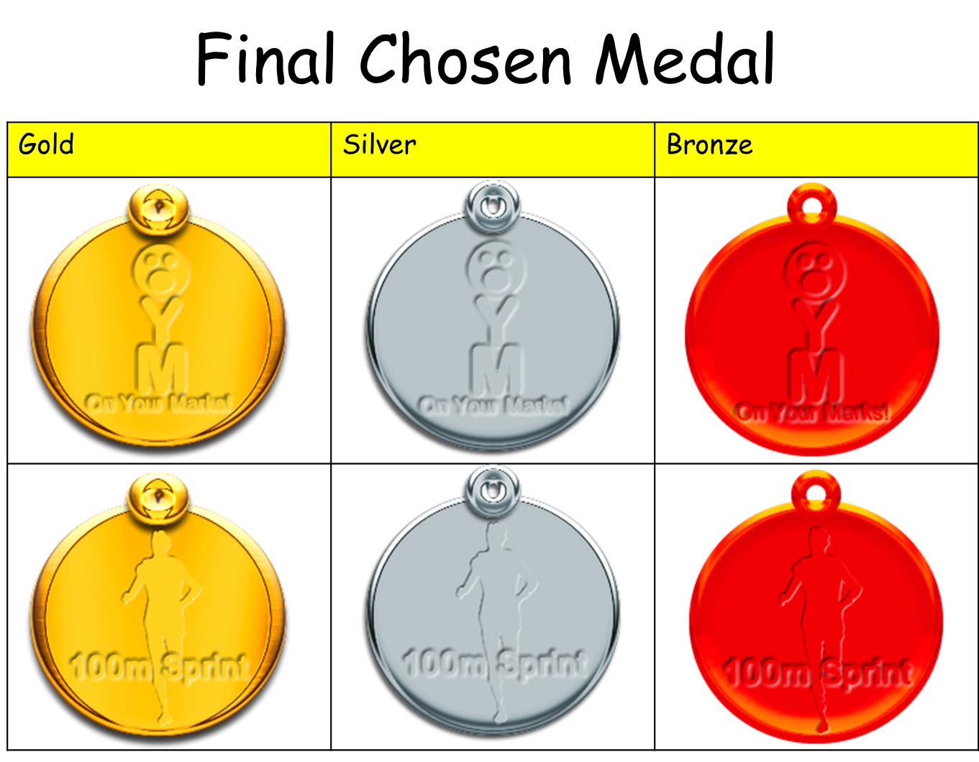

Slide 9
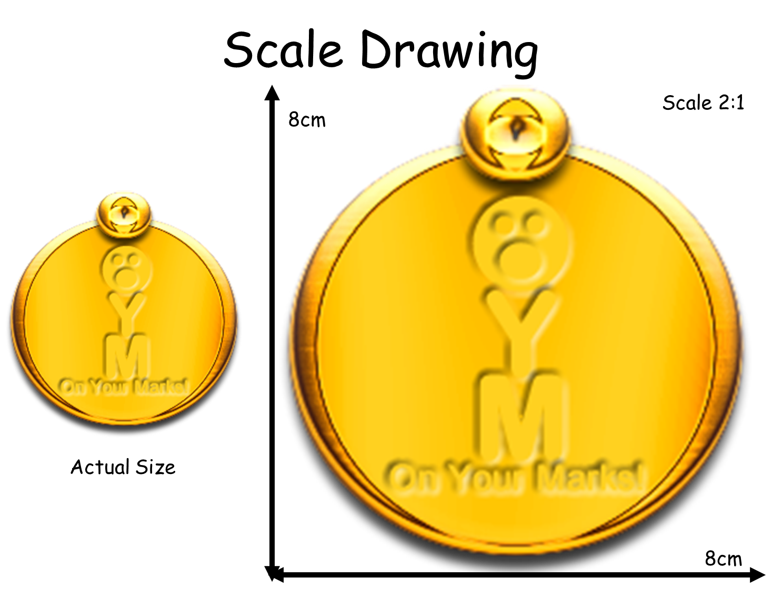

Slide 10
